Slide 1

Natural Language Processing DLO 8012
Subject In-charge
Ms Vincy Joseph
Assistant Professor
email: vincyjoseph@sfit.ac.in

Slide 2
Module VI
Lecture 33 Applications of NLP

Slide 3
Information Retrieval System

Slide 4
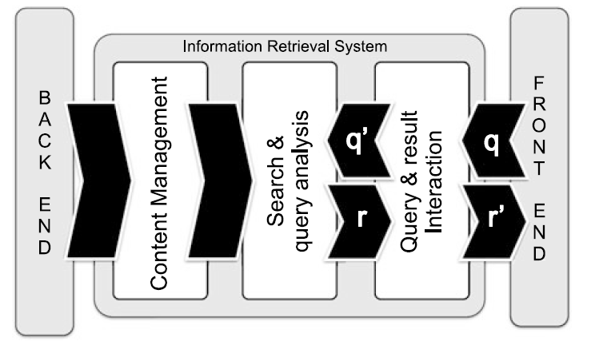
Information Retrieval System

Slide 5
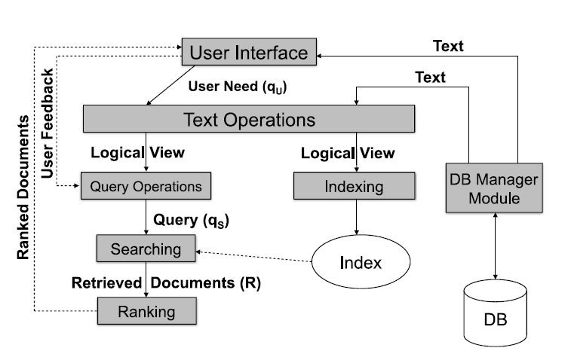
Information Retrieval : Text

Slide 6
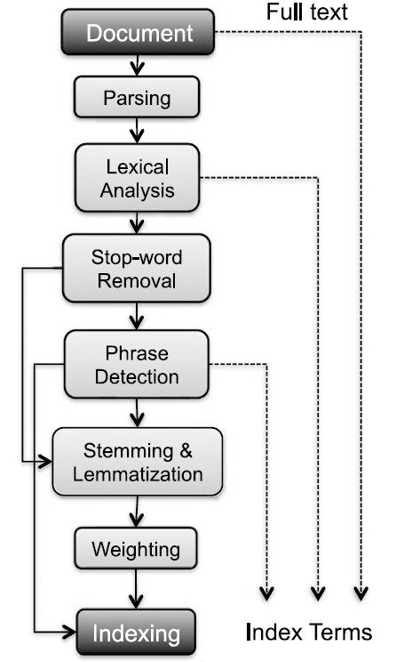
Textual Operations
The textual preprocessing phase typically performed by an IR engine, takes as input a document and yields its index terms as output.
The process of this extraction is given in the figure.

Slide 7
Question Answering System (QAS)

Slide 8
Question Answering System (QAS)
QASs attempt to answer questions asked by users in natural languages after retrieving and processing information from different data sources.
The format of answers may also vary from simple text to multimedia.

Slide 9
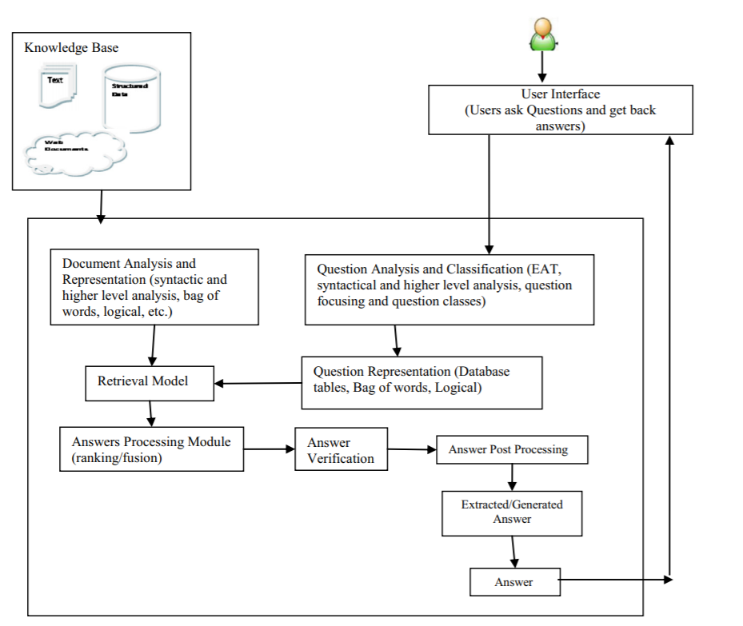
General Architecture of a QAS

Slide 10
Question Answering System (QAS)
A typical Question Answering System, consists of three main modules:
Question Analysis
Answer Retrieval
Answer Generation.

Slide 11
Question Analysis
The question analysis module :
takes natural language questions as input
specifies what the question is asking for, like location, date, person’s name etc.,
Aims to understand question purpose and meaning.
Understand the question : The question should be analyzed in different ways.

Slide 12
Morpho-syntactic analysis of the question
Firstly, carry out the morph-syntactic analysis of words in the question.
This is done by POS tagging.
After POS tagging, find out the questioning information (what the question is looking for).
A question class helps the system to classify the question type to provide a suitable answer

Slide 13
Question Analysis
To get the meaning of the question, we need to classify the question semantic type.
Question classification means to classify the question into pre-defined semantic categories which leads to consider different strategies of processing.

Slide 14
Question Classification
Question classification process is used to generate possible question classes.
For example, a question can seek for date, time, location, or person.
E.g. The question “Who was the first American in space?” is expecting that the person's name is in the answer
The search space of reasonable answers will be definitely reduced here.

Slide 15
Question Analysis
Once the question type is recognized, the question analysis need to recognize more constraints that the questions description type must meet.
This process is simple as taking out keywords from the question and find candidate answer sentences.
These keywords may then be extended by using morphological and/or synonyms replacements or using query expansion techniques.
They form representation of the question.

Slide 16
Answer Retrieval
It involves the following steps:
Document Retrieval
Document Processing
Syntactic Analysis
Semantic Analysis
Relation Identification

Slide 17
Document Retrieval
This module selects a set of relevant documents from a domain specific repository.
Conceptual indexing is used for the retrieval process since the keyword based indexing ignores the semantic content of the document collection.
Both the documents and queries can be mapped into concepts and these concepts are used as a conceptual indexing space for identifying and extracting documents.

Slide 18
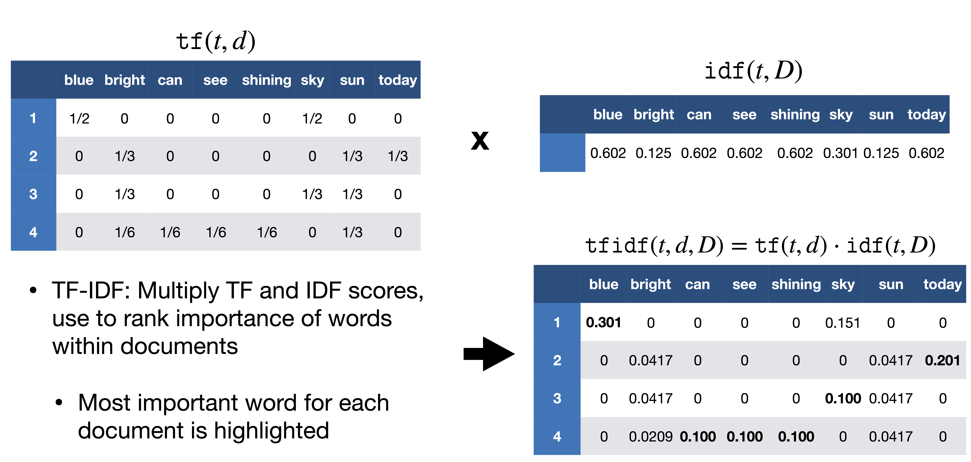

Slide 19
Document Processing
The retrieved documents are processed for extracting candidate answer set.
This module is responsible for selecting the response based on the relevant fragments of the documents.

Slide 20
Syntactic Analysis
The documents are analyzed syntactically using the NLP techniques such as POS tagging and NER.
Firstly the documents are tokenized into a set of sentences. Then the POS tagging and NER is performed.
Shallow parsing is performed to identify the phrasal chunks.
The chunks identified in the question analysis module are matched with those identified in the document and relevant sentences are retrieved.

Slide 21
Semantic Analysis
Shallow parsing can be performed for finding the semantic phrases or clauses.
Semantic roles are identified and mapped to semantic frames.
The sentences whose semantic frames map exactly to the semantic frames of the question are also extracted.

Slide 22
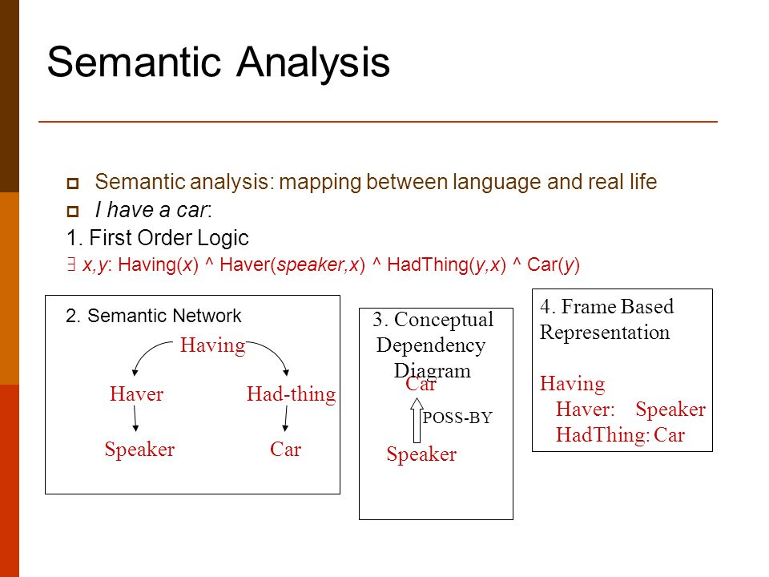

Slide 23
Relation Identification
The base ontology is populated with the domain knowledge incrementally as we go through different sets of documents.
By this method a valid knowledge of any specialized discipline can be incorporated into the system.
The relations among different concepts are identified using the domain knowledge and the ontological information is obtained.

Slide 24
Answer Generation
The filtering of candidate answer set and answer generation is performed.
The user is supplied with a set of short and specific answers ranked according to their relevance.
The different stages are:
Filtering
Answer Ranking
Answer Generation

Slide 25
Filtering
The extracted sentences are filtered and the candidate answer set is produced.
This is done by incorporating the information obtained from the question classification and document processing modules.
The identified focus and frames are matched to get the candidate set.

Slide 26
Answer Ranking
The answer set is ranked based on the semantic similarity.
Simple template matching is not adopted since it neglects the semantic content and domain knowledge.
Answers are ranked based on the similarity between the question frame and the answer frame.
Example: The event E “John gave a balloon to the kid.” has the roles “AGENT verb/give THEME to RECIPIENT, the semantic frame is identified as
“has_possession(start(E),Agent,Theme)
has_possession (end(E),Recipient, Theme)
transfer(during(E), Theme)”
matches exactly with the question frame : “Who give balloon to the kid?”.

Slide 27
Answer Generation
From the answer set, specific answers have to be generated in case the direct answers are not available.
Hidden relations can be identified from the domain knowledge gathered from the ontology.
Concept of natural language generation can also be utilized for this purpose.

Slide 28
General Architecture of a QAS

